Slide 1
Session 3.1 Intro to CSS 3

Slide 2
Contents
CSS Basics
Types of CSS
General Syntax
Using a stylesheet on page
CSS properties

Slide 3
CSS Basic
CSS = Cascading Style Sheets
Used to style a HTML document
Separates presentation from structure
Can be changed without changing HTML
Notes:
Using CSS, One HTML page displayed with different style sheets.
When tags like <font>, and color attributes were added to the HTML 3.2 specification, it started a nightmare for web developers. Development of large web sites, where fonts and color information were added to every single page, became a long and expensive process.
To solve this problem, the World Wide Web Consortium (W3C) created CSS.
In HTML 4.0, all formatting could (and should!) be removed from the HTML document, and stored in a separate CSS file.

Slide 4
Types of CSS
CSS can be added to HTML documents in 3 ways:
Inline - by using the style attribute inside HTML elements.
Internal(Embedded) - by using a <style> element in the <head> section.
External - by using a <link> element to link to an external CSS file.

Slide 5
Inline CSS
The Inline style is specific to the tag itself. The inline style uses the HTML “style” attribute to style a specific tag. Every CSS change has to be made in every tag that has the inline style applied to it. The inline style is good for one an individual CSS change that you do not use repeatedly through the site.
<p style="color:red;font-size:18px">This is a paragraph!</p>

Slide 6
Embedded CSS
An embedded stylesheet holds the CSS code for the web page in the head section of the particular file. This makes it easy to apply like classes or id’s in order to reuse the code. The downside of using an embedded stylesheet is that changes to the embedded stylesheet only effect the page the code is inserted into.
<head> <style> hr {color: sienna;} p {margin-left: 20px;} body {background-image: url("images/background.gif");} </style> </head>

Slide 7
External CSS
The external stylesheet in a “.css” file that you link your website to. This makes it so that what ever you change in the .css sheet, will effect every page in your website. This prevents you from having to make many code changes in each page. This is for “global” site changes.
#sample.css
<link rel="stylesheet" type="text/css“ href="CSS/type.css">
hr {color: sienna;} p {margin-left: 20px;} body
{background-image: url("images/background.gif");
}

Slide 8
Media Queries
Media Queries work fine on modern browsers (IE9, FF, Chrome, Safari, Opera) and on mobile devices (iPhone, Android, Opera Mobile & Mini, Blackberry, IE Mobile 7, etc.)
A media query consists of a media type and at least one expression that limits the style sheets' scope by using media features, such as width, height, and color.
Media queries, added in CSS3, let the presentation of content be tailored to a specific range of output devices without having to change the content itself.
Notes:
A media query consists of a media type and at least one expression that limits the style sheets' scope by using media features, such as width, height, and color. Media queries, added in CSS3, let the presentation of content be tailored to a specific range of output devices without having to change the content itself.
Syntax
Media queries consist of a media type and can, as of the CSS3 specification, contain one or more expressions, expressed as media features, which resolve to either true or false. The result of the query is true if the media type specified in the media query matches the type of device the document is being displayed on and all expressions in the media query are true.

Slide 9
General Syntax
Selector {
Property: value;
}

Slide 10
Selectors in CSS
Element type of selector
Class & ID
Pseudoclasses
Descendent and child selectors
Attribute selector

Slide 11
Element selector
Any HTML element by its name
* means all elements
Demo
Notes:
The element selector selects elements based on the element name.

Slide 12
Element selector
<!- - index.html - ->
<!doctype html>
<html>
<head>
<meta charset="utf-8">
<title>ABCD Industries</title>
<link rel="stylesheet“ type="text/css” href="CSS/type.css">
</head>
<body>
<h1>Welcome to ABCD Industries</h1>
</body>
</html>

Slide 13
Element selector (CSS)
@charset "utf-8";
/* CSS Document */
{
margin:0;
border:0;
padding:0;
}
body/* this is an html element*/
{
background-color:#903;
}
h1
{color:#0CC;
}

Slide 14
Class and ID
Class is used for common styling of elements
ID is used for unique styling for an element
Demo
Notes:
The id selector uses the id attribute of an HTML element to select a specific element.
An id should be unique within a page, so the id selector is used if you want to select a single, unique element.
To select an element with a specific id, write a hash character, followed by the id of the element.
The class selector selects elements with a specific class attribute.
To select elements with a specific class, write a period character, followed by the name of the class:

Slide 15
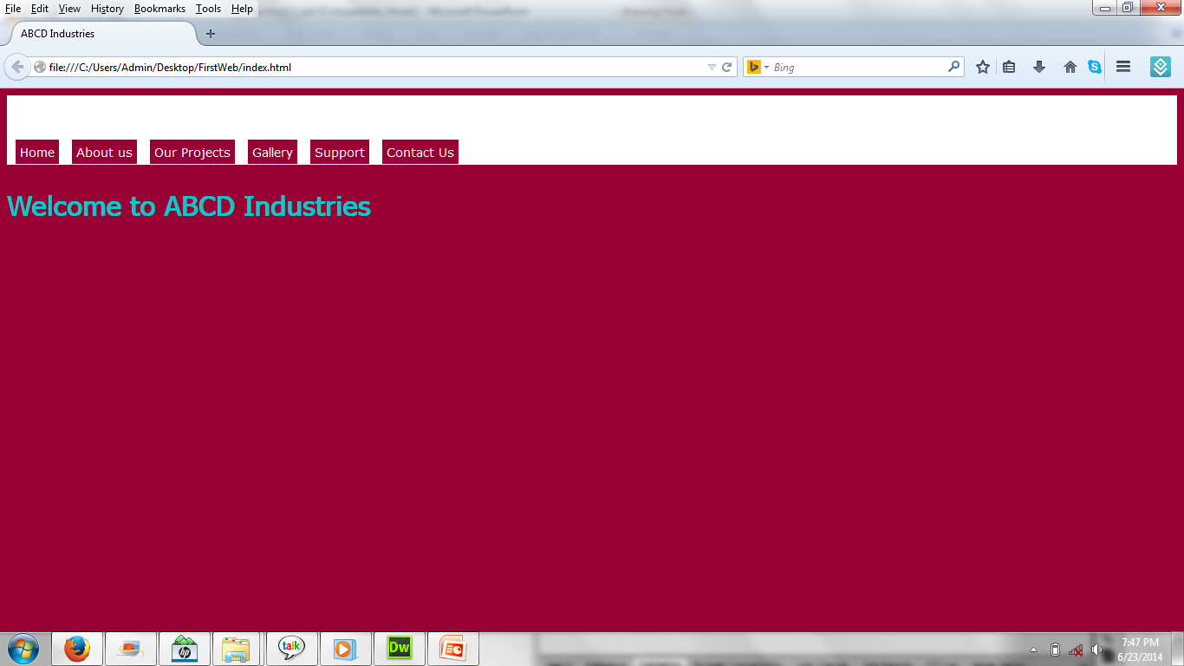
Class and ID

Slide 16
Class and ID (index.html)
<body>
<header>
<nav id="mainNav">
<a class="navlinks" href="#">Home</a>
<a class="navlinks" href="#">About us</a>
<a class="navlinks" href="#">Our Projects</a>
<a class="navlinks" href="#">Gallery</a>
<a class="navlinks" href="#">Support</a>
<a class="navlinks" href="#">Contact Us</a>
</nav>
</header>
<h1>Welcome to ABCD Industries</h1>
</body>

Slide 17
Class and ID (CSS)
header
{background-color:#FFF;
width:100%;
height:80px;
}
.navlinks
{
background-color:#903;
color:#FFF;
padding:5px;
margin-left:10px;
font-family:Verdana, Geneva, sans-serif;
font-size:14px;
text-decoration:none;
}
#mainNav
{ margin-top:52px;
float:left;
}

Slide 18
Pseudoclasses in CSS
Defines a state of an element
E.g., Hover, Focus, Active, Visited etc…
Demo
.navlinks:hover
{
background-color:#FFF;
color:#903;
}
Notes:
What are Pseudo-classes?
A pseudo-class is used to define a special state of an element.
For example, it can be used to:
Style an element when a user mouses over it
Style visited and unvisited links differently
Syntax
The syntax of pseudo-classes:
selector:pseudo-class { property:value; }

Slide 19
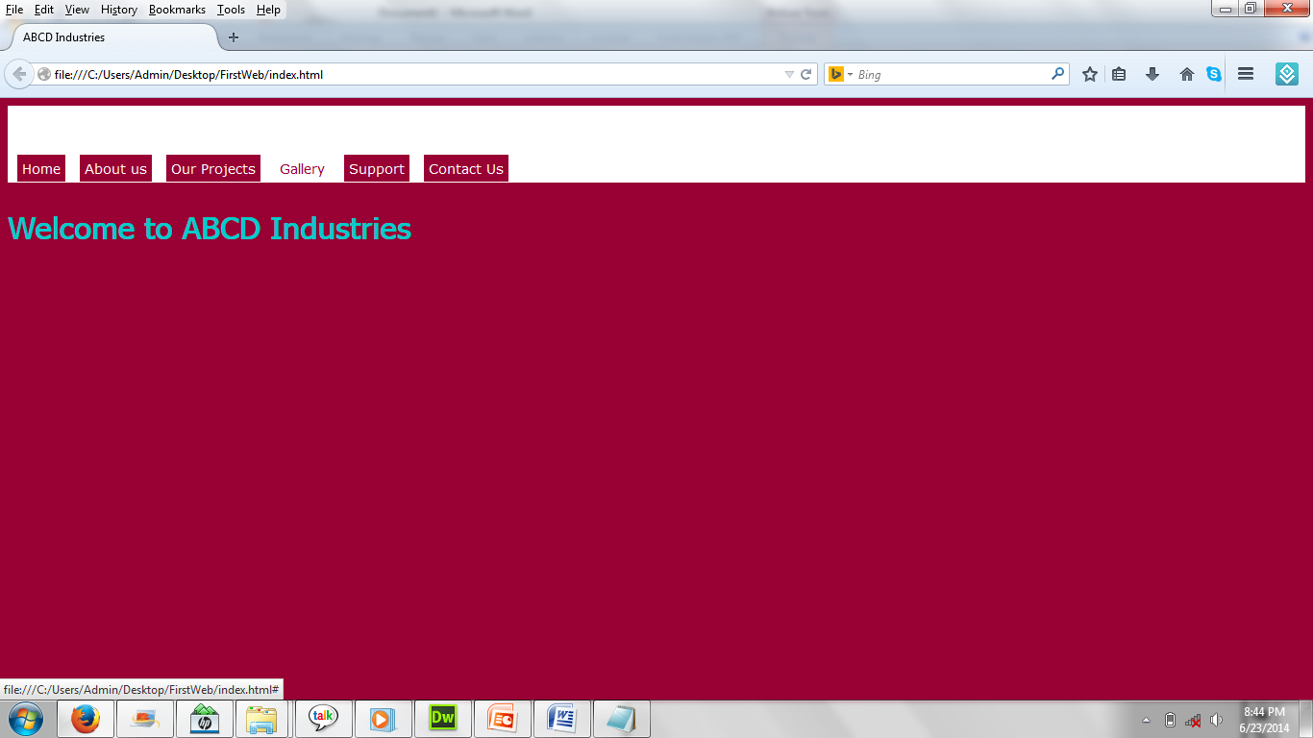
Pseudoclasses in CSS

Slide 20
Descendant and child Selector
element A> element B: means element B is child of element A
E.g., child element of a parent element =>
ul (parent), li(child)
element A element B: means element is a descendant of element A
E.g., element inside another element =>
div and paragraph or paragraph and span
Demo

Slide 21
Descendant and child Selector
<div id="maincontent">
<p> </p>
<p> </p>
</div>
#maincontent p
{ width:80%;
color:#FFF;
line-height:25px;
font-family:Verdana, Geneva, sans-serif;
margin-top:20px;
text-align:justify;
}
Notes:
Select and style every <p> element where the parent is a <div> element:
div > p { background-color: yellow; }

Slide 22
Attribute Selector in CSS
Syntax;
Element[attribute= “value”]
Targets all elements by name with a particular attribute set
Demo

Slide 23
Attribute Selector in CSS
<form>
<input type="text" name="firstname"/>
<input type="radio" name="gender"/>
<input type="checkbox" name="hobby"/>
<input type="email" name="emailname"/>
</form>
input[type="email"]
{
background-color:#FF0;
padding:5px;
}

Slide 24
Using a stylesheet on page
Creating an external stylesheet and linking on page
Demo
<link rel="stylesheet" type="text/css" href="CSS/type.css">

Slide 25
CSS properties
Backgrounds and Borders
Text Effects
2D/3D Transformations
Animations
Multiple Column Layout
User Interface

Slide 26
Thank you!

